Slide 1
Build an Application Using Java on the Eclipse, connect it the MySQL Database & deploy it Tomcat server
Submitted by
RUPAMA MAJEE
Registration No-ADIT19AU03269 of 2019-2021
PARAMITA DEWAN
Registration No-ADIT19AU00945 of 2019-2021
Under The Mentorship Of
ARPITA ROY
National Skill Training Institute of Salt Lake
Address: CP-16, CP Block, Sector V, Salt Lake City,
Kolkata-700091, West Bengal.

Slide 2
ACKNOWLEDGEMENT
We would like to extend our sincere thanks to all of them. We are highly indebted to the teacher in charge “ARPITA ROY” (Edunet Foundation) for his able guidance and constant supervision as well as providing necessary information regarding the project. We would also like to extend our gratitude to our principal sir of NSTI (W)Salt lake Kolkata, “SRI G.C RAMAMURTHY “ & trade in charge of Adv. Diploma in Cloud Computing And Networking “MR. SARBOJIT NEOGI “ for providing golden opportunity of this project. We are really thankful to our group and our team member, who helped us a lot in finalizing the project within the limited time frame.
Rupama Majee
Date: - 07/06/2021 Paramita Dewan

Slide 3
TABLE OF CONTENTS
Sl. no. | TOPICS | Page no.
1 | Introduction | 4
2 | Background | 5
 | Introduction to Java | 6
 | Introduction to MySQL | 7
 | Introduction to Eclipse IDE | 8
4 | Create a Project in Eclipse | 9
5 | Conclusion | 20
6 | Challenges | 21
7 | Bibliography | 22

Slide 4
Introduction
In this activity you will see how to use Eclipse to create and test a very simple web service.
This thesis work reflects a strong experience of Java programming language, and knowledge of connecting the applications with database. A step by step demonstration of how to do Java project in Eclipse, has been presented. There are certain questions as following that have been answered:
How to build an application of Java SE, using Eclipse IDE?
How to connect a Java application with database in Eclipse.
The development procedure for the application required the following steps:
Layout of the user Interface
Coding for the application
Creation of database & Connecting the database with application
Deploying the application in the Tomcat Server

Slide 5
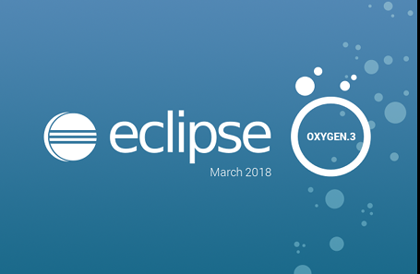


Background
In this chapter, the theoretical background for Java, MySQL and Eclipse software is presented.

Slide 6
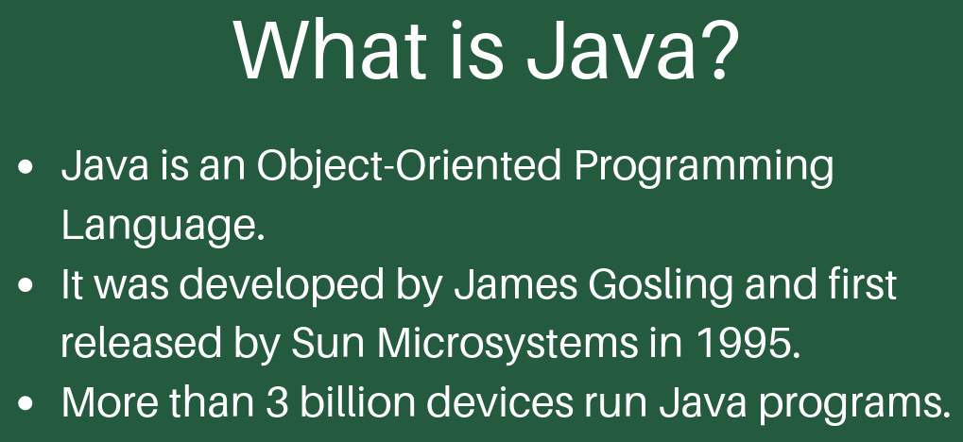
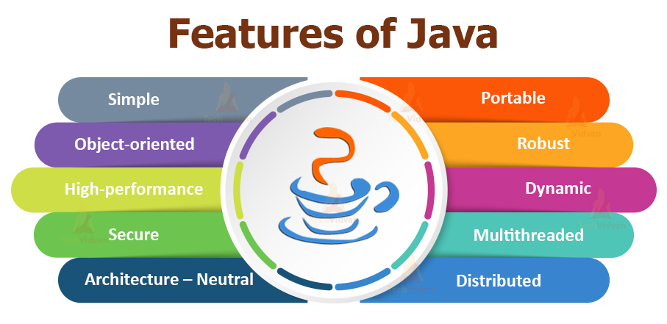
Introduction to Java

Slide 7
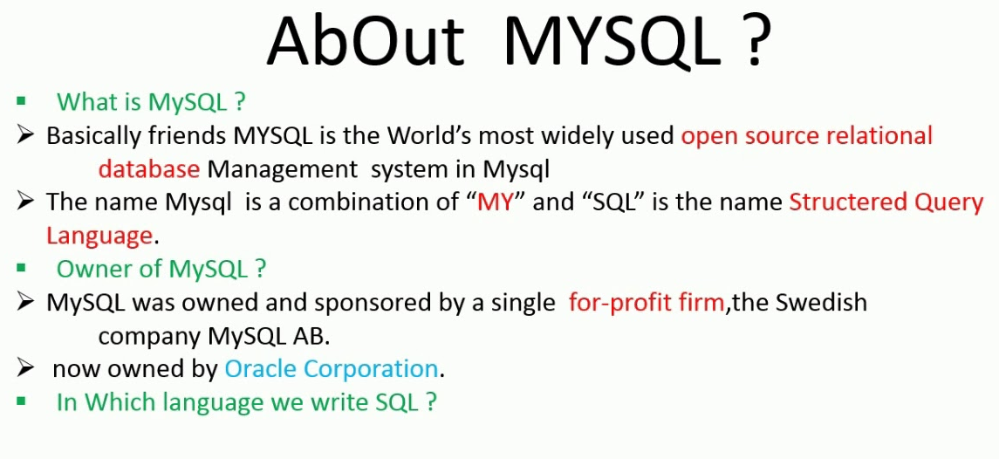
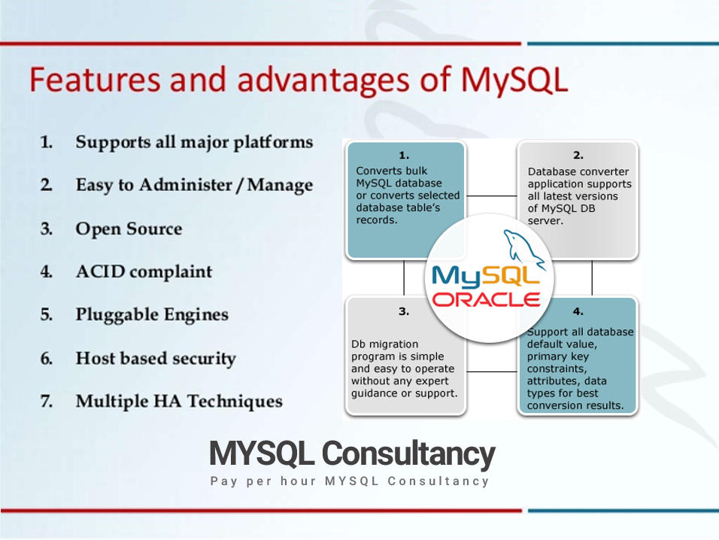
Introduction to MySQL

Slide 8
Introduction to Eclipse IDE
Eclipse is a multi-lingual software development environment, which consists of integrated development environment (IDE) and extra plug-in system.
Eclipse is one of the IDEs which are mostly used professionally to develop applications and software solutions. An advantage of Eclipse over other professional IDEs is that Eclipse is an open source platform.

Slide 9
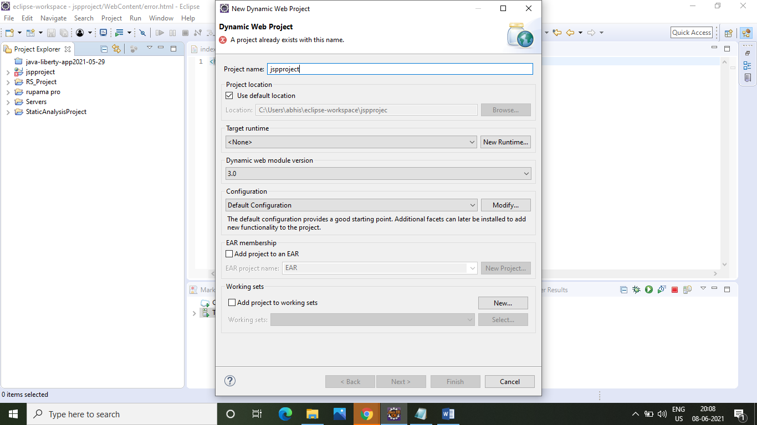
Create a Project in Eclipse
Open the “eclipse.exe” file in windows. Then Click File> New > Dynamic Web Project > enter the name of the project & Click Finish.

Slide 10
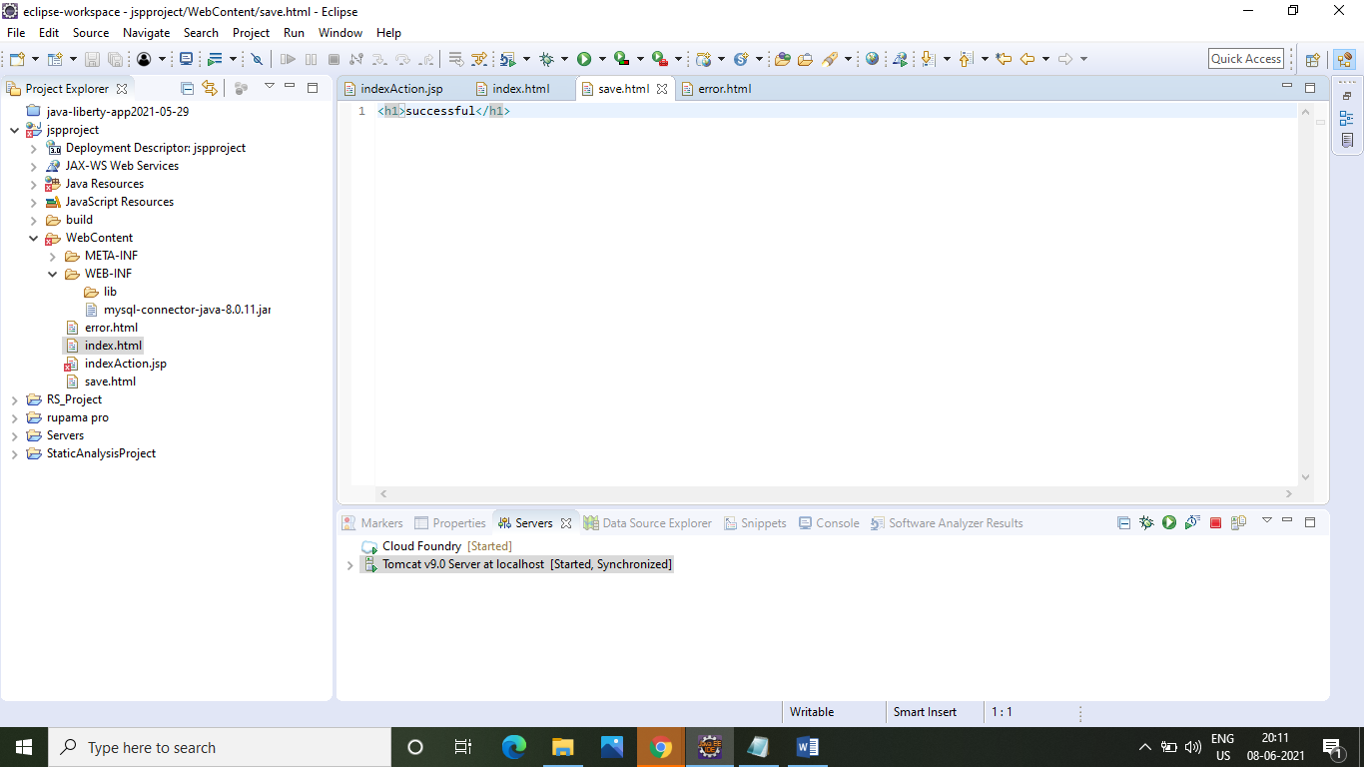

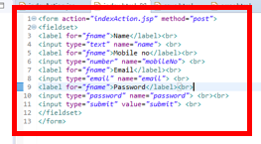

After successfully create the project then create a 3 HTML file. Select the project name & right click New>Others>Web>HTML file>next> Finest. 3 HTML file name is – “index.html”, “save.html”, “error.html”. After that write a code.

Slide 11
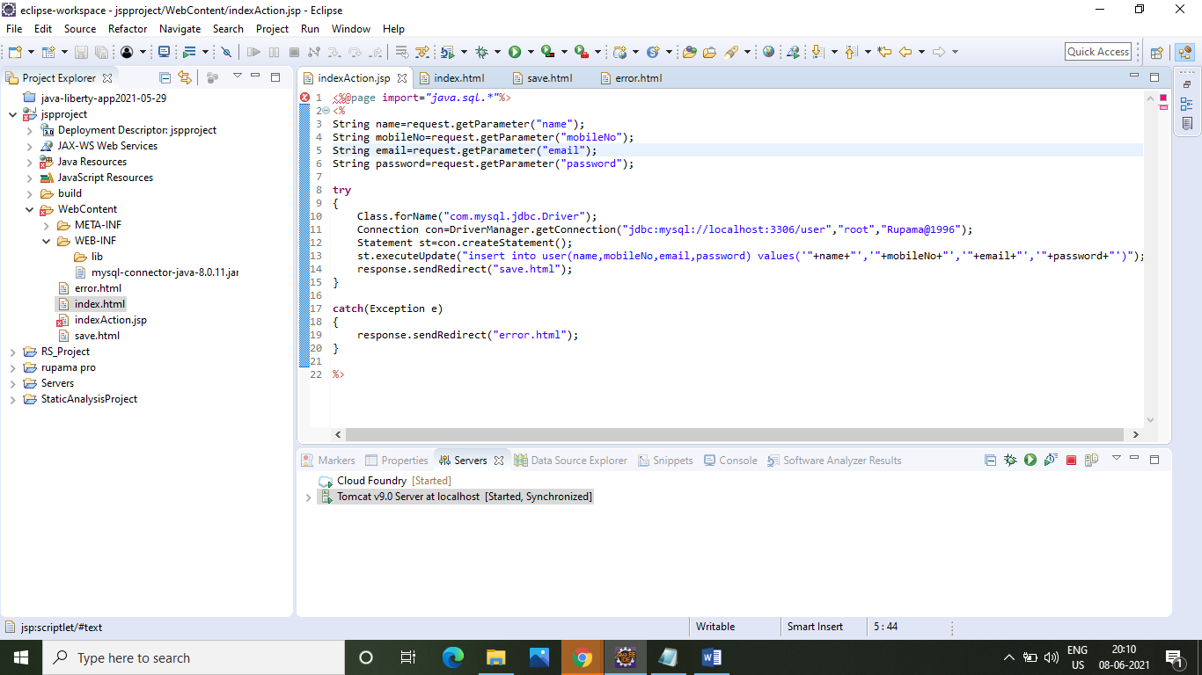
After that create JSP file. Select the project name & right click New>Others>Web>JSP file>next> Finest. JSP file name is – “indexAction.jsp”. After that write a code.

Slide 12
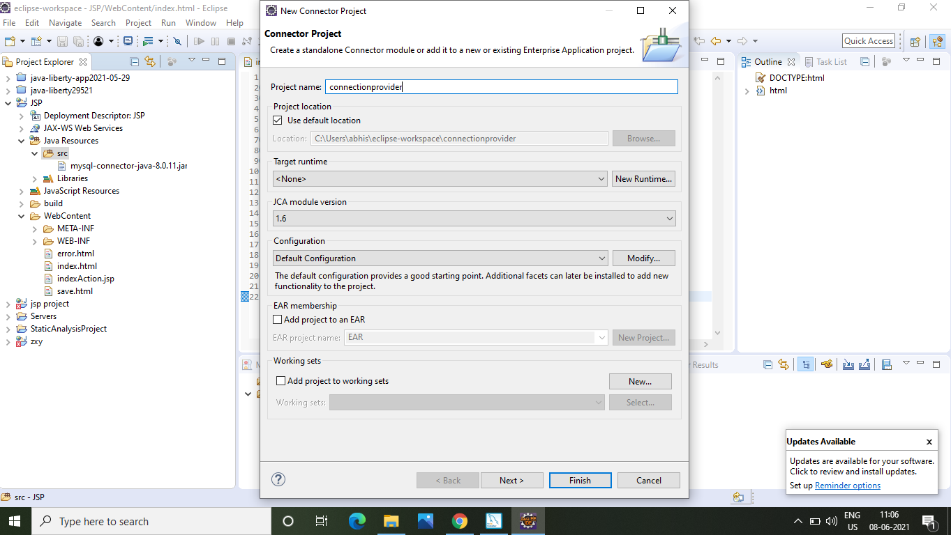
After that create a connector project, Click File > connector project & give the project name > next> finish.

Slide 13
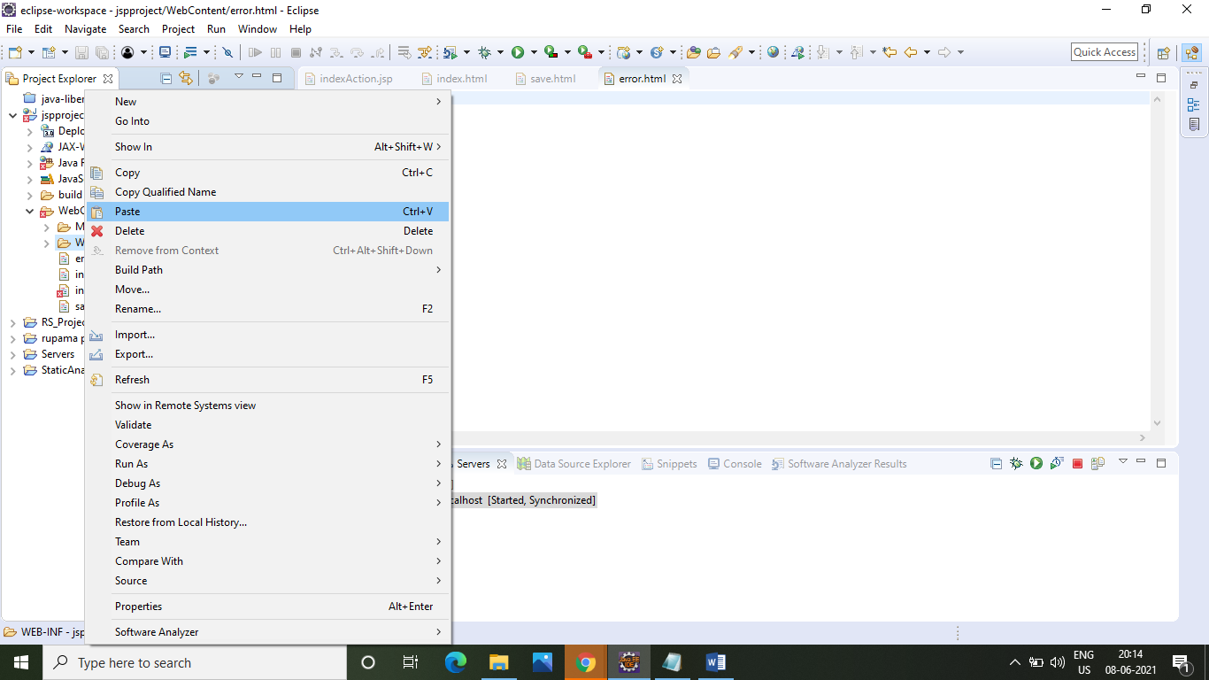
After that open File Explore > copy the mysql-connector-java-8.0.19 (jar file).After that select the location right click where paste this file

Slide 14
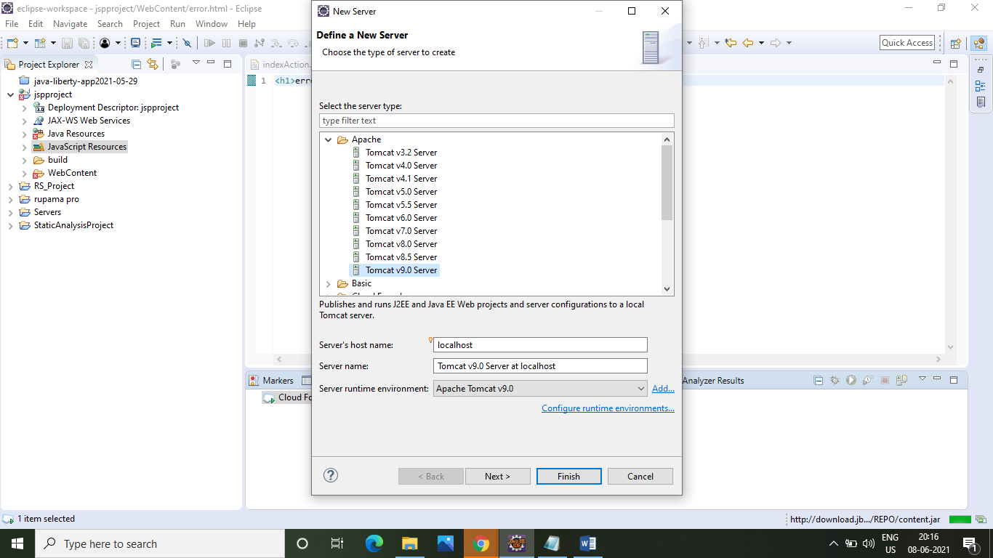
After that create a serve, go to the Server>right Click the link>New > Server After that to select Apache > Tomcat v9.0 Server > Next& click Finish.

Slide 15
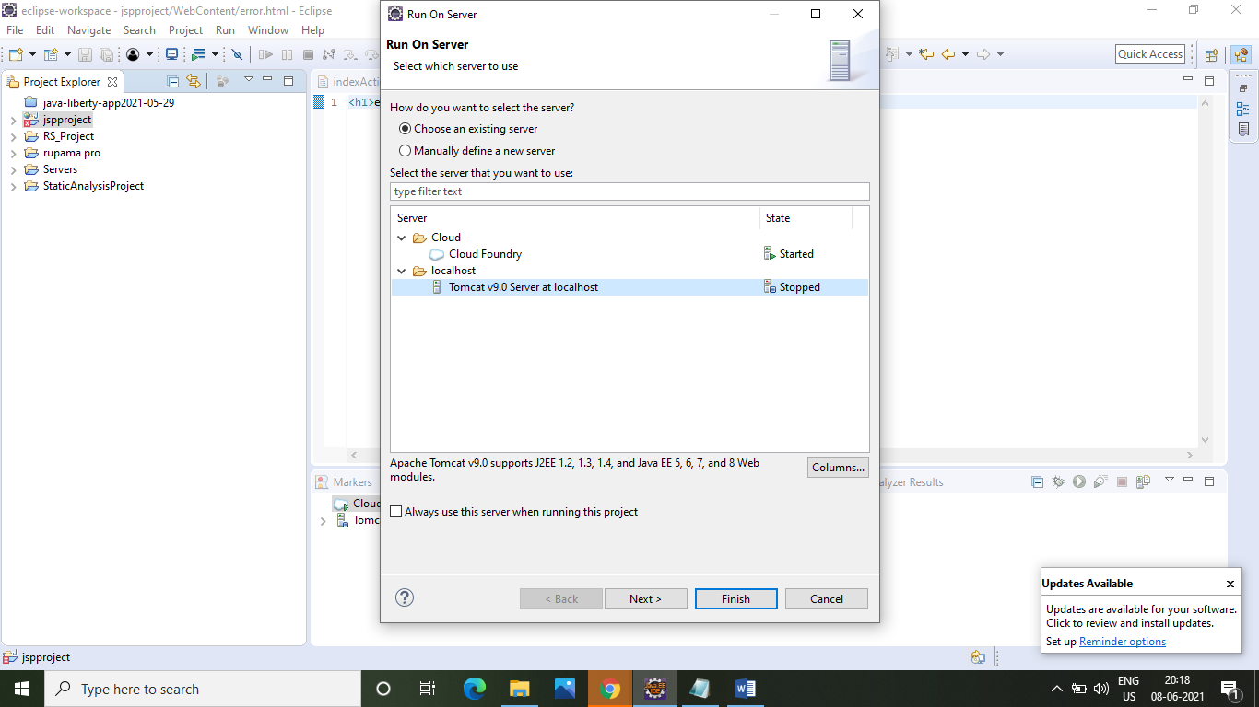
After that successful create a Tomcat Server, Click project file > Run As > 1 Run on Server. After that select Tomcat > Finish.

Slide 16
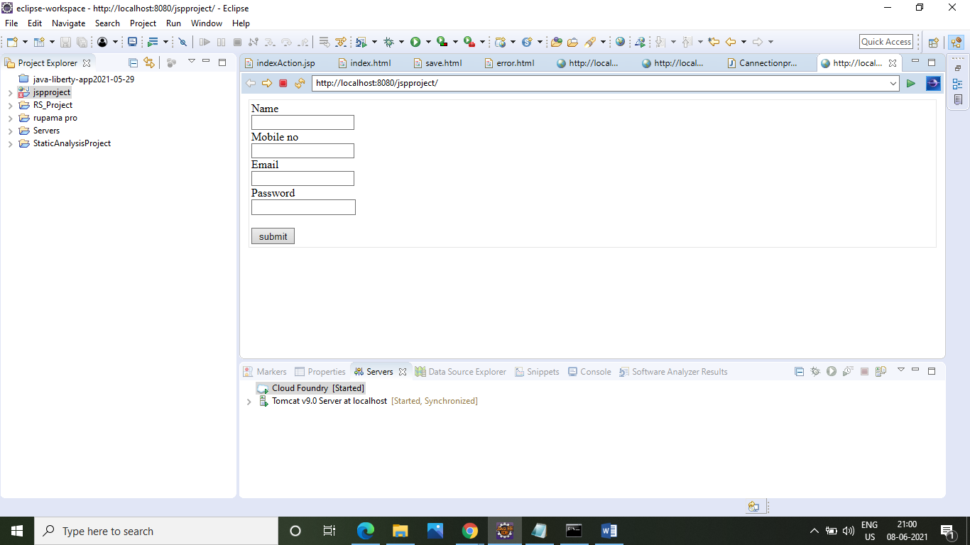
After that to successfully deploy the project on localhost to using Tomcat server.

Slide 17
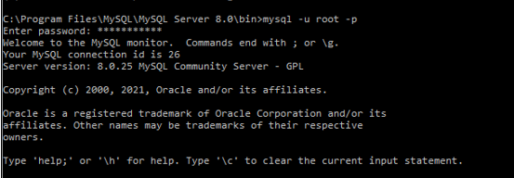
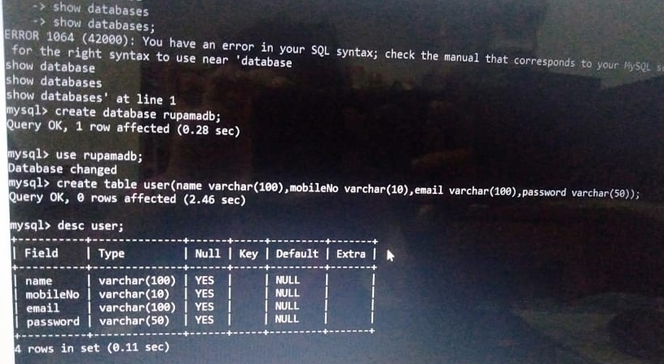
After that now open CMD > & write MySQL syntax. To create a database & table & connect it to our application.

Slide 18
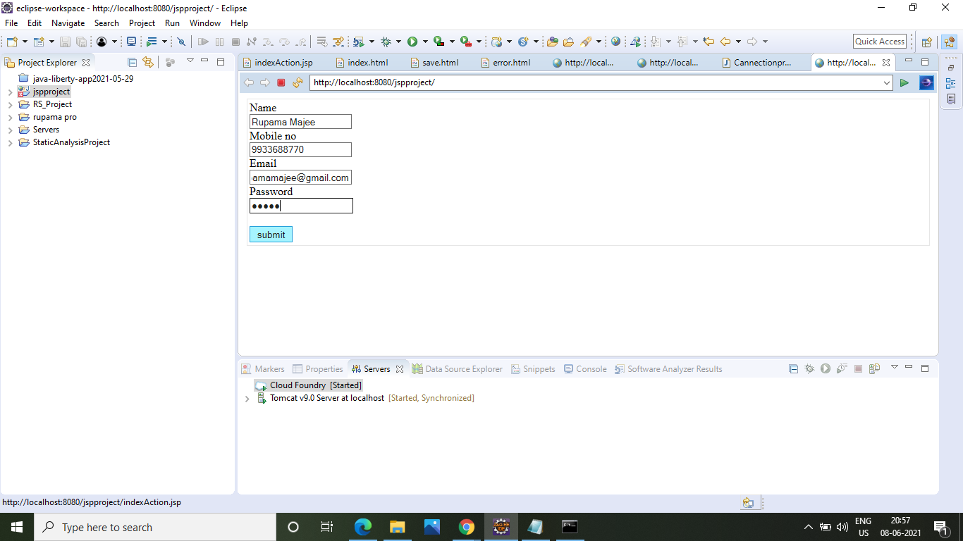
After that go to the eclipse & enter the correct data & enter the submit button to store this data on the database. When data successfully submitted then show the successful page.

Slide 19
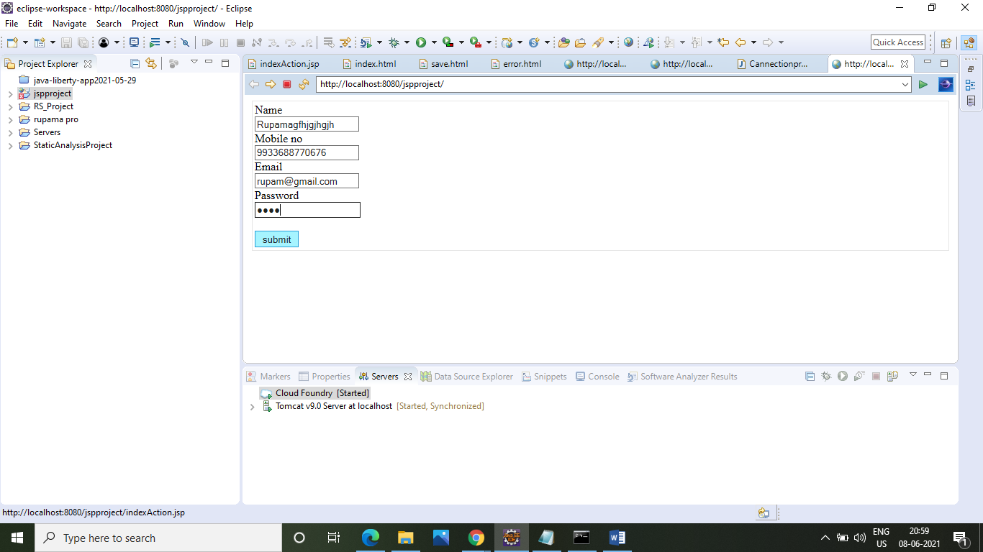

Or we enter the incorrect data & enter the submit button to store this data on the database.

Slide 20
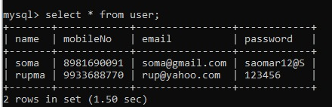
Data store in the table format to use “from user” command.

Slide 21
Conclusion
Application development in Eclipse environment has been explained and the experiment to develop Java desktop application has been done. The tasks which were covered in the study are as follows:
Step wise explanation of how to develop Java applications in Eclipse IDE.
How to connect between Java applications on MySQL Database.
How to deploy Java applications on Tomcat server.

Slide 22
Challenges
The challenge of this project is that our team members worked very hard to collect data from different sources for completion of the project, we have used Eclipse & MySQL open sources software. Some time we have faced so many technical issue with our devices, application push unsuccessful, but our team members are very supportive and hardworking so we have successful to overcome the problematic situation. Our team spirit is the fuel that allows us to accomplish our project.

Slide 23
Bibliography
To accomplish the project of “BUILD AN APPLICATION USING JAVA ON THE ECLIPSE, CONNECT IT THE MYSQL DATABASE & DEPLOY IT TOMCAT SERVER” we take help of the following sites:
https://www.google.com/url?sa=i&url=https%3A%2F%2Fwww.journaldev.com%2F32975%2Fwhat-is-java-programming-language&psig=AOvVaw3pNzTe4VUtQE-YbbJAQ-uG&ust=1623333779408000&source=images&cd=vfe&ved=0CAIQjRxqFwoTCODNk-TbivECFQAAAAAdAAAAABAO
https://www.google.com/url?sa=i&url=https%3A%2F%2F1000logos.net%2Fjava-logo%2F&psig=AOvVaw3nkLmWgs6ue6hX7-wD1y3_&ust=1623334387302000&source=images&cd=vfe&ved=0CAIQjRxqFwoTCOj49oLeivECFQAAAAAdAAAAABAD
https://www.google.com/url?sa=i&url=https%3A%2F%2Fwww.youtube.com%2Fwatch%3Fv%3DfNiw8YGMG4Q&psig=AOvVaw3VI15hIUVFXPaF-GWLtT5t&ust=1623334687898000&source=images&cd=vfe&ved=0CAIQjRxqFwoTCLCZ1ZLfivECFQAAAAAdAAAAABAO
https://www.google.com/url?sa=i&url=https%3A%2F%2Fwww.deviantart.com%2Fclivingstone%2Fart%2FMySQL-Database-Features-and-advantages-677340348&psig=AOvVaw1gzXhsjd81JVnrZVDk5M7-&ust=1623335080216000&source=images&cd=vfe&ved=0CAIQjRxqFwoTCMiV5M_givECFQAAAAAdAAAAABAD

Slide 24

Thank You

